Slide 1
Self Introduction
IMU_Zhouchenyang
chenyangzhou19940217@gmail.com
2018-09-05

Slide 2
CV(Curriculum Vitae)
Name:Chenyang Zhou
Age:24(1994)
Sex:Male
HomeTown:Yakeshi(ᠶᠠᠭᠰᠢ ᠬᠣᠲᠠ)
Programming Language:C++,Java,Python.
Graduation:IMUT(Inner Mongolia University of Technology)
Github:https:github.com/imuzcy
Blog:imuzcy.github.io

Slide 3
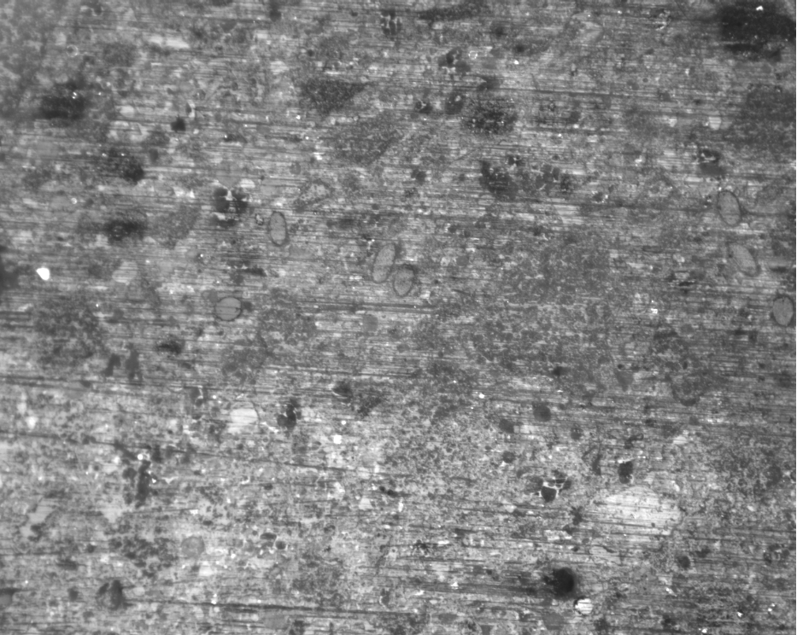
Graduation Project
CV
Identification PVA fiber

Slide 4
Research Interests
NLP(Natural Language Processing)
CV(Computer Vision)
Machine Learning
Deep Learning
Data Mining
Algorithm
Mathematics

Slide 5
Course
Whether it's NLP or CV, you need to learn math.
It's necessary to learn Python and C++.
Course address:(Bilibili.com)
--Machine Learning
https://study.163.com/course/introduction/1004570029.htm

Slide 6
We are a team.
医不自医 人不渡己

